Slide 1
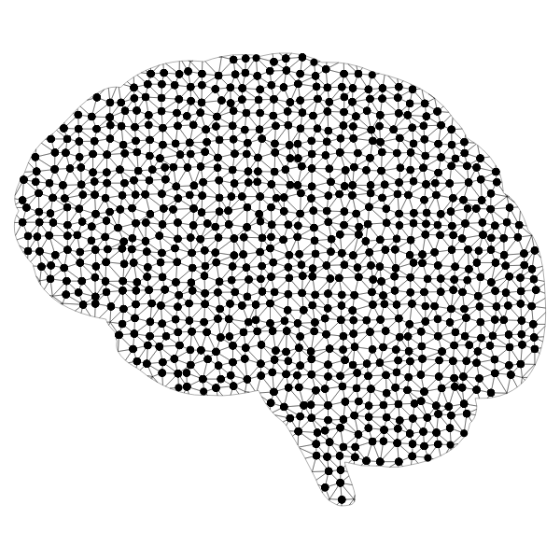

AI ToolKits in MATLAB

Slide 2
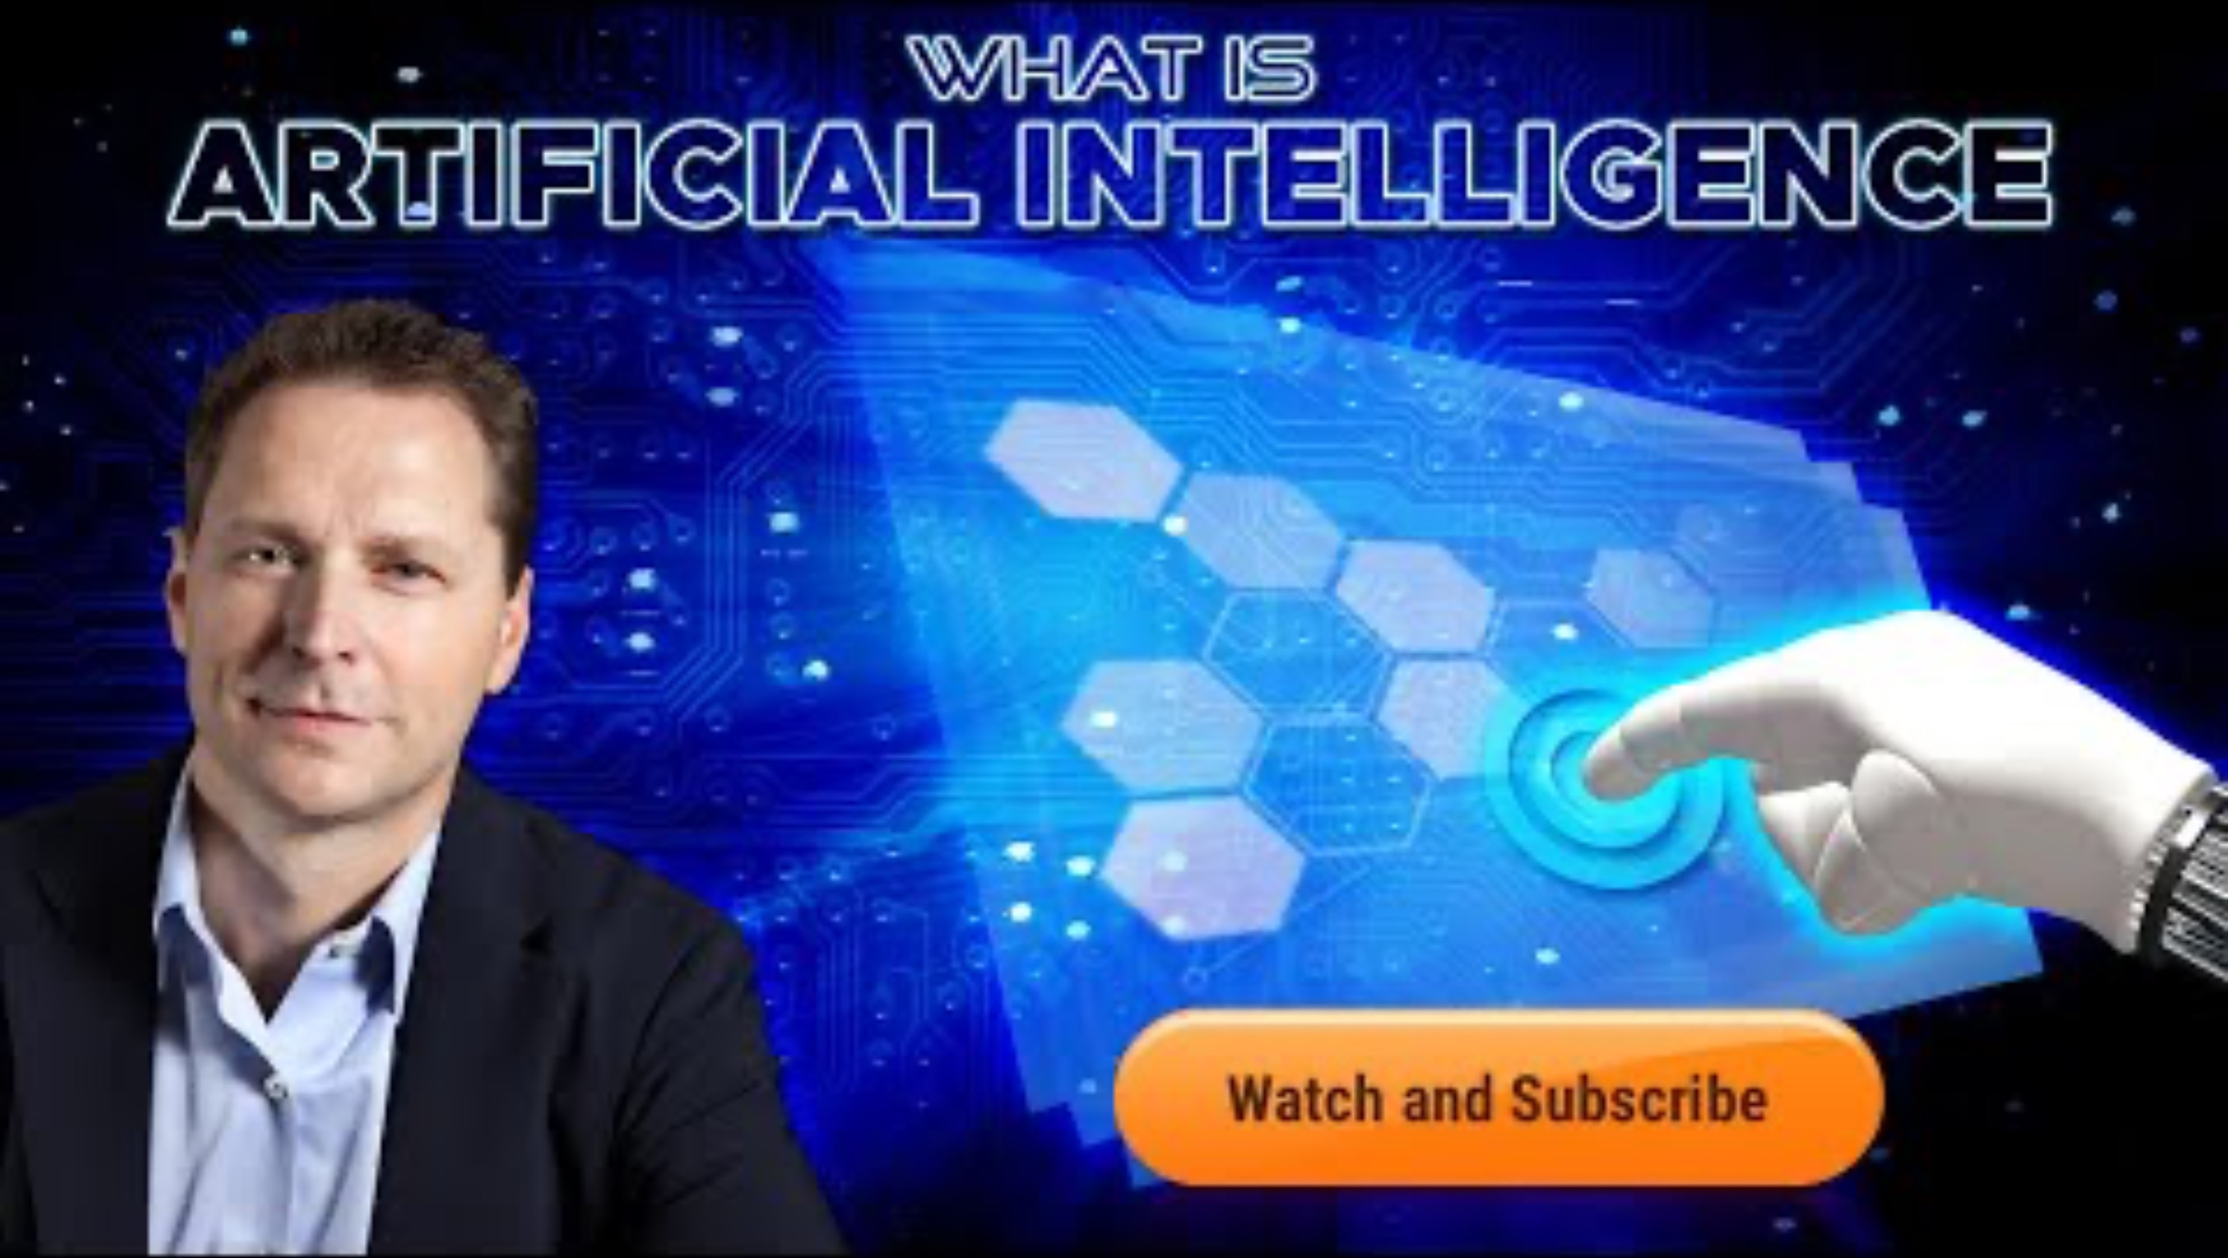
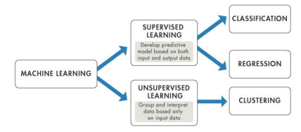
So... What is Artificial Intelligence Anyways?
First, we will watch a short 8-minute video that introduces the concept of artificial intelligence, please click on the following link to the YouTube website:
Let's discuss the following question:
How does AI, akin to using APIs and web scraping, gather data to suggest content?

Slide 3
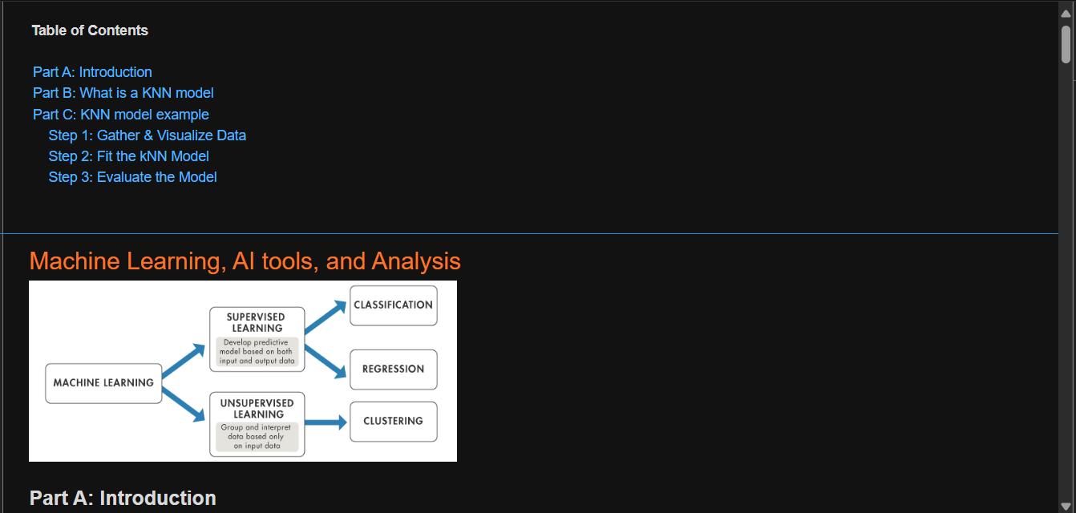


Exploring AI with MATLAB
Please copy over the files for Section 05 from the MATLAB Drive
The MATLAB files for this section can be found at this link.
Notes:
The URL on this slide is for the student version of the files, please see the teacher guide for the teacher version of the files You can also find the teacher and student links on the master document with all the youtube video and matlab drive links for every section on it

Slide 4
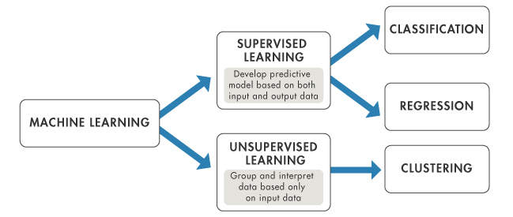
Machine Learning, AI tools, and Analysis
Part A: Introduction
Imagine teaching a computer to learn from examples, just like how you learn from practice problems in math class. That's what machine learning is about, and MATLAB makes it easy to explore. It's like having a virtual lab where you can play with data and teach your computer to recognize patterns or make predictions without telling it exactly what to do.
With MATLAB, you can create cool projects like predicting future stock prices or identifying handwritten digits. It's not just about coding; it's about teaching computers to think a bit like us. So, if you're curious about how computers learn and want to dive into the world of AI, MATLAB is your playground!

Slide 5
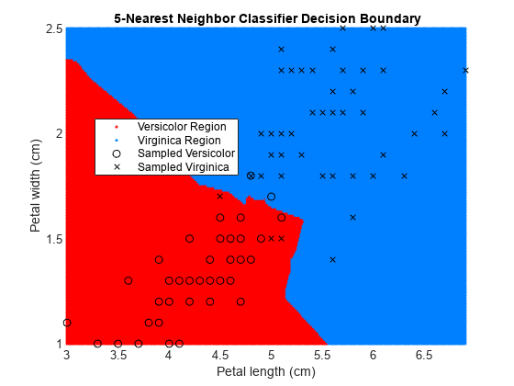
Machine Learning, AI tools, and Analysis
Part B: What is a KNN Model?
Imagine you’re a music enthusiast building a recommendation system. The K-Nearest Neighbors (KNN) model is like having a group of friends who help you make recommendations based on the countless songs they've listened to.
In the KNN model, when you give it a new data point, it looks at the 'nearest neighbors' – the data points closest to it – and makes a decision based on what those neighbors are like.
It’s a straightforward approach that adapts well to various problems like classification, regression, and recommendation systems. Plus, it doesn't require training beforehand; it learns as it goes.

Slide 6
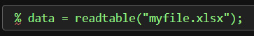
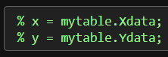
Machine Learning, AI tools, and Analysis
Part C: KNN Model Example
All models require data, so first we are going to review how use the readtable() function and dot notation to import data stored in a spreadsheet or text file.
The code on the right shows how to import the data from the spreadsheet myfile.xlsx and store it in a table variable called data.
The first line of code extracts the variable Xdata from the table mytable and stores the result in a new variable named x using dot notation. Similarly, the second line of code extracts the variable Ydata into y.

Slide 7
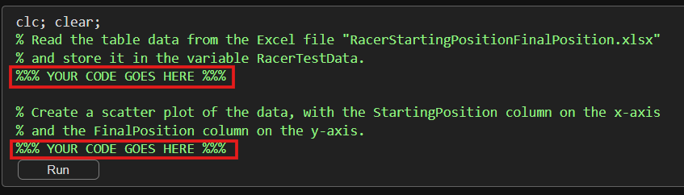
Machine Learning, AI tools, and Analysis
Step 1: Gather & Visualize Data
Alright, now that we all remember how to extract data from files let's start working with the xlsx file RacerStartingPositionFinalPosition.xlsx which contains a table of 56 starting and final positions for 5 drivers from 13 races in the 2022 Formula 1 season. The table has three variables: StartingPosition, FinalPosition, and Driver.
Try It!
Plot the extracted features from RacerStartingPositionFinalPosition.xlsx, by using the scatter() function, with StartingPosition on the horizontal axis and FinalPosition on the vertical axis.

Slide 8
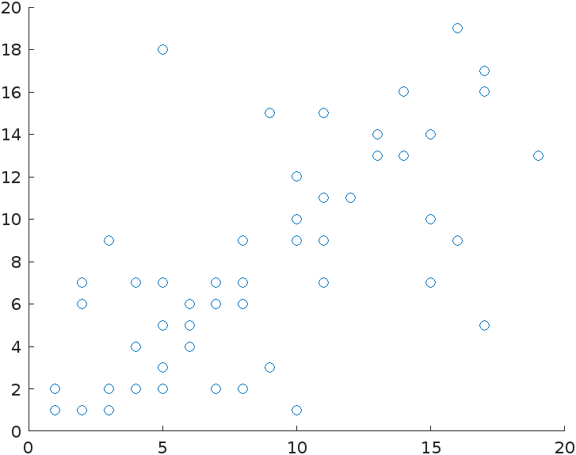
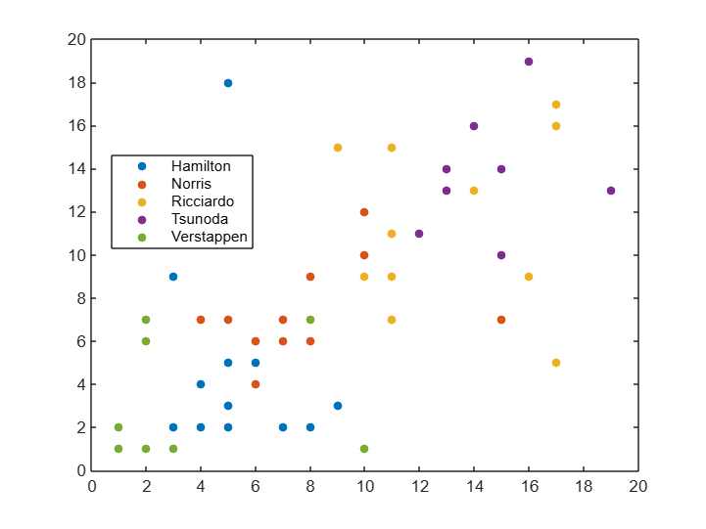
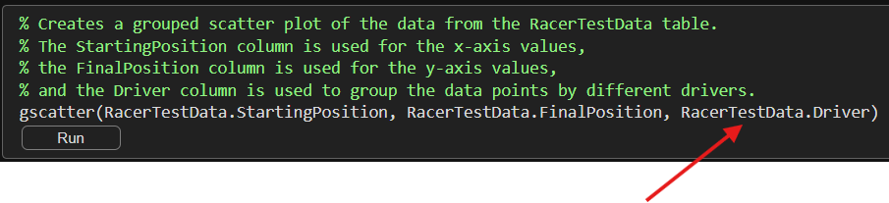
Machine Learning, AI tools, and Analysis
Step 1: Gather & Visualize Data
One issue with the current plot is that we can't distinguish the 5 drivers in the data set (Verstappen, Hamilton, Norris, Tsunoda, and Ricciardo ). The gscatter() function makes a grouped scatter plot: a scatter plot where the points are colored according to a grouping variable.
Let's use the gscatter() function to create the same scatter plot as before but grouped by the driver.
The 3rd input tells the function how to group the data points.

Slide 9
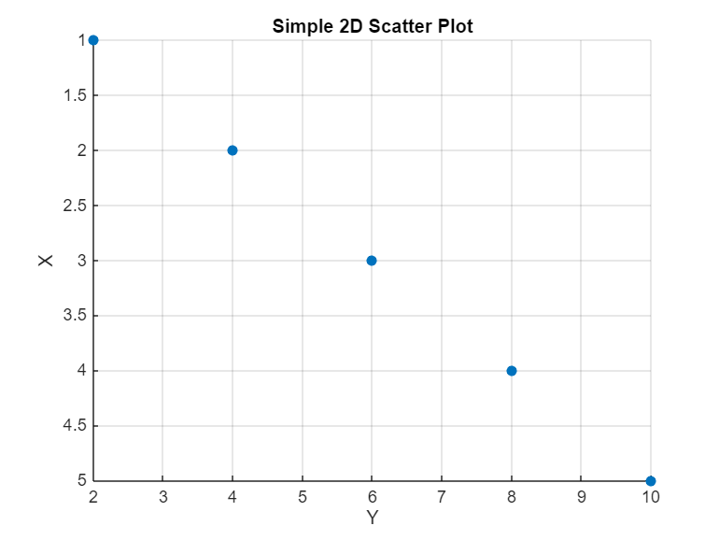
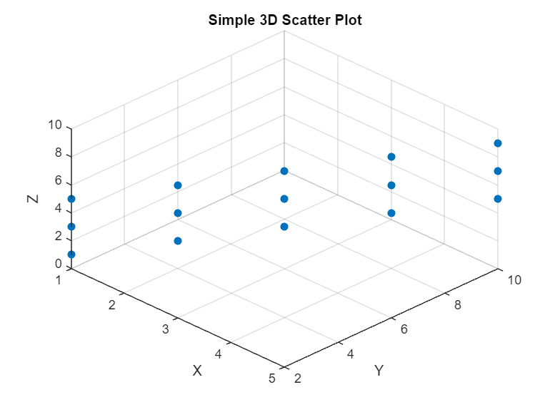
Machine Learning, AI tools, and Analysis
Step 1: Gather & Visualize Data
Good job! It appears the new scatter plot worked. However, distinguishing between multiple drivers remains challenging due to overlapping data points. To address the overlapping data, we need to use 3D scatter plot. Unlike 2D plots which only have two axes (x, y), a 3D plot has three axes (x, y, z).
These images shows two simple scatter plots, which both contain 15 data points.
However, overlapping makes it appear that the 2D plot only has 5 data points. For this reason, you need a 3D plot to get the full picture.

Slide 10
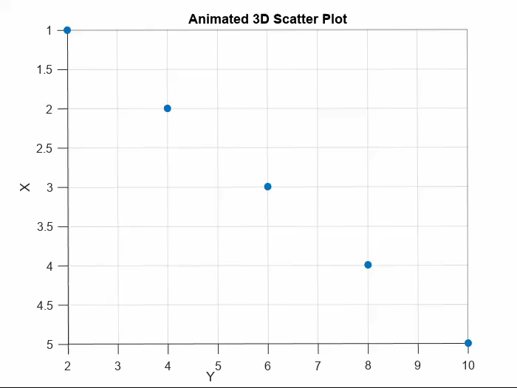
Machine Learning, AI tools, and Analysis
Step 1: Gather & Visualize Data
Here is an animation to help you visualize the example on the previous slide!
On the next slide is a step-by-step code and comments to guide you through the creation of a 3D plot for the driver data!

Slide 11
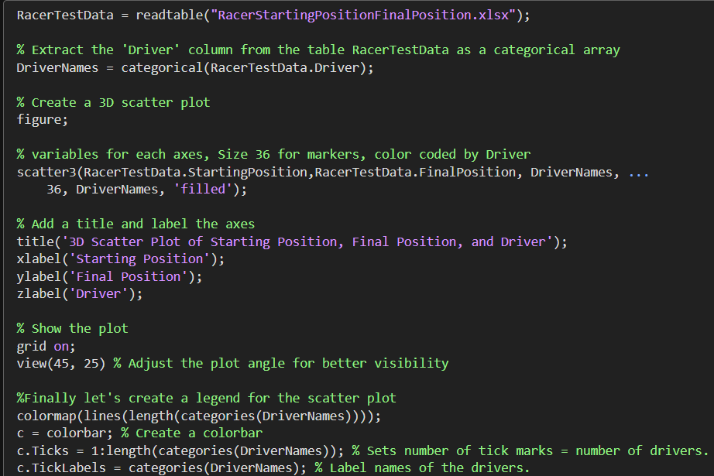
Machine Learning, AI tools, and Analysis
Step 1: Gather & Visualize Data
Extract and save the driver’s names in a categorical data
Use scatter3() function to makes a 3D plot with the x-axis as ‘Starting Position’, y-axis as ‘Final Position’, and z-axis as ‘Drivers’. Group the plot by driver name.
Add appropriate title and label all the axes.
Adjust the view of the plot
Make legend for the plot in the form of a color bar.

Slide 12
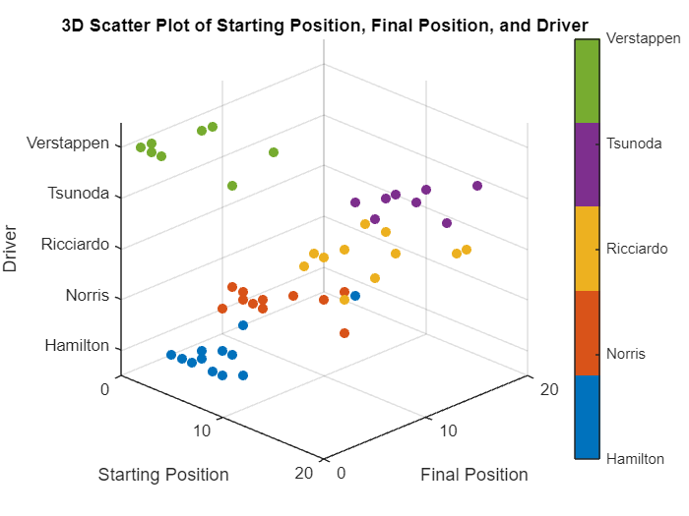
Machine Learning, AI tools, and Analysis
Step 1: Gather & Visualize Data
Now we can actually see all of the data clearly! It is important to correctly visualize your data, so that you can fully understand what it represents.

Slide 13

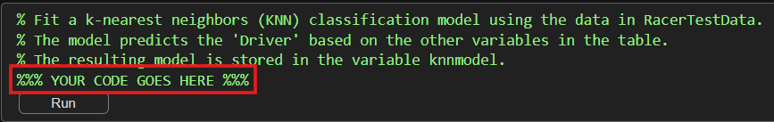
Machine Learning, AI tools, and Analysis
Step 2: Fit the KNN Model
Now that we have successfully visualized the data, we can begin to working with the KNN model. You can fit a KNN model by passing a table of data through the fitcknn() function.
% mdl = fitcknn(data,"ResponseVariable");
The second input is the name of the response variable in the table (the class you want the model to predict). The output is a variable containing the fitted model.
Now You Try It!
Fit a model to the data stored in RacerTestData by using the fitcknn() function. The known classes are stored in the variable named Driver. Store the resulting model in a variable named knnmodel.
The class names in the output should be Hamilton, Norris, Ricciardo, Tsunoda, & Verstappen.

Slide 14
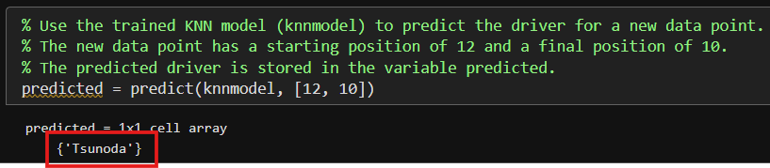

Machine Learning, AI tools, and Analysis
Step 2: Fit the KNN Model
The model is now ready to start making predictions using the predict() function. % predClass = predict(model,newdata)
The inputs are the trained model and the observations. The output is a categorical array of predictions for each observation in newdata.
The code above uses the predict() function along with the trained model knnmodel to determine, which racer is likely to have a starting position of 12 and a final position of 10. Based on the inputs the model predicts that the driver is Tsunoda.

Slide 15
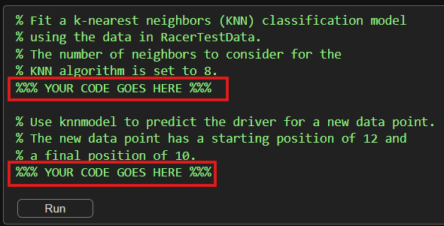
Machine Learning, AI tools, and Analysis
Step 2: Fit the KNN Model
Another feature of the KNN model is that you can specify the value of k in the kNN model by setting the "NumNeighbors" option when calling fitcknn.
Adjusting the number of nearest neighbors the model utilizes can have an impact on the model's prediction, so let’s rerun the model to see if the prediction changes.
Now You Try It!
Repeat the commands from the previous tasks but use the "NumNeighbors" option to change the number of neighbors in the model to 8.
% mdl = fitcknn(data,"ResponseVariable”, ...
"NumNeighbors",10);

Slide 16
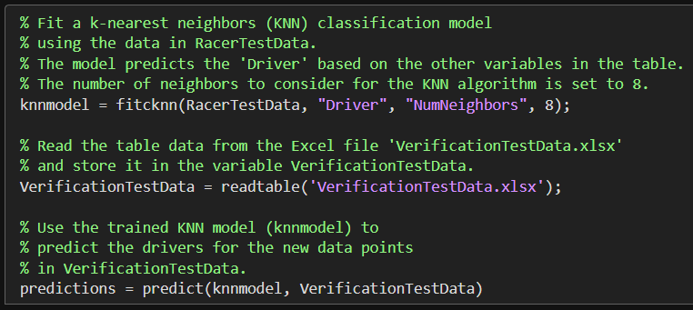
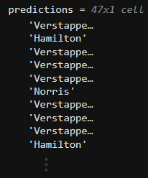
Machine Learning, AI tools, and Analysis
Step 3: Evaluate the Model
How good is the kNN model? You can use the model to make predictions, but how accurate are those predictions? Typically, you want to test the model by having it make predictions on observations for which you know the correct classification.
The file VerificationTestData.xlsx contains a table, that has the same variables as RacerTestData, including the known classes for the test observations. You can use the predict function to determine the predictions of the KNN model for the observations in Verificationtestdata, and then compare the predictions to the known classes to see how well the model performs.
Array of predictions based on the verification test data

Slide 17
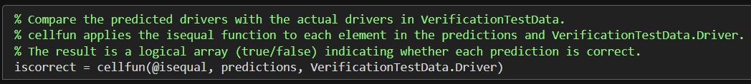
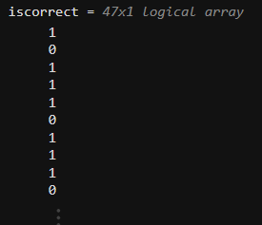
Machine Learning, AI tools, and Analysis
Step 3: Evaluate the Model
Now that we have made some predictions using our trained KNN model and we can compare them to the correct results stored in the variable Verificationtestdata.
To compare predictions to the known classes we can use the @isequal operator as shown in the code below.
1 means the prediction is accurate.

Slide 18
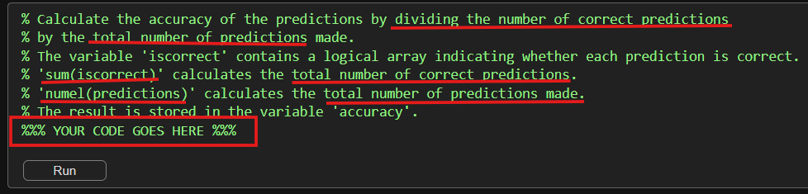
Machine Learning, AI tools, and Analysis
Step 3: Evaluate the Model
The logical array shows us which predictions that are correct by marking their position with the number 1. To quantify the accuracy of our kNN model we can divide the number of correct predictions by the total number of predictions.
Try It!
Calculate the accuracy of the model and store the result in a variable named accuracy. You can use the sum() function to determine the number of correct predictions and the numel() function to determine the total number of predictions.

Slide 19
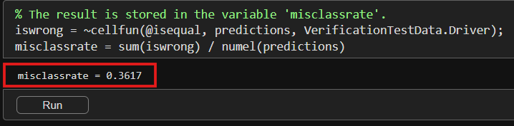
Machine Learning, AI tools, and Analysis
Step 3: Evaluate the Model
Rather than accuracy (the proportion of correct predictions), a commonly used metric to evaluate a model is misclassification rate (the proportion of incorrect predictions).
To determine the misclassification rate, we divide the number of wrong predictions by the total number of predictions made. In the code below, the variable iswrong contains a logical array indicating whether each prediction is incorrect. The line sum(iswrong) calculates the total number of wrong predictions and numel(predictions) calculates the total number of predictions made.

Slide 20
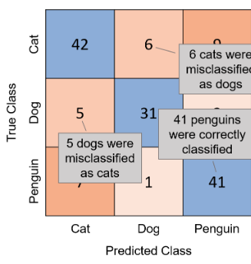
Machine Learning, AI tools, and Analysis
Step 3: Evaluate the Model
Accuracy and misclassification rate give single values for the overall performance of the model, but it can be useful to see a more detailed breakdown of which classes the model confuses.
A confusion matrix shows the number of observations for each combination of true and predicted class. A confusion matrix is commonly visualized by shading the elements according to their value.
Often the diagonal elements (the correct classifications) are shaded in one color and the other elements (the incorrect classifications) in another color. You can visualize a confusion matrix by using the confusionchart() function.
%confusionchart(ytrue,ypred);
Where ytrue is a vector of the known classes and ypred is a vector of the predicted classes.

Slide 21
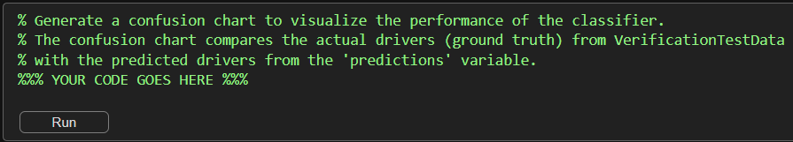
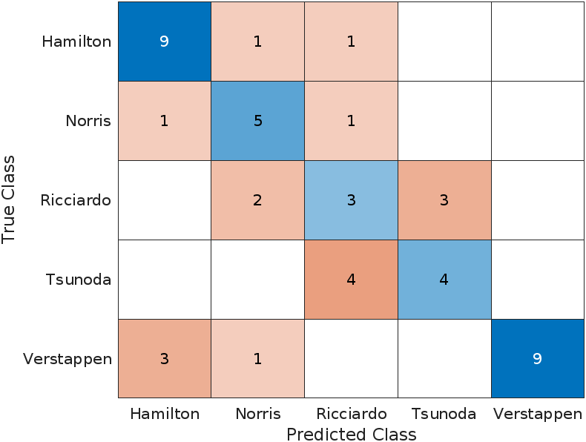
Machine Learning, AI tools, and Analysis
Step 3: Evaluate the Model
Now You Try It!
Compare predictions to the known labels (stored in the variable Driver in the table VerficationTestData) by using the confusionchart() function.
The resulting confusion matrix should look like the one on the left.

Slide 22
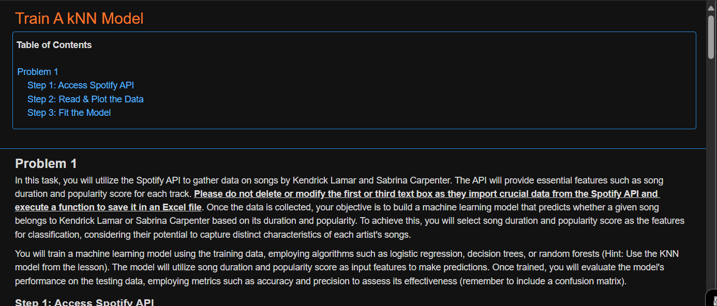
Train A KNN Model
Please copy over the files for Section 05 from the MATLAB Drive, the Part 2 live script should be in the same folder.
The MATLAB files for this section can be found at this link.
Notes:
The URL on this slide is for the student version of the files, please see the teacher guide for the teacher version of the files You can also find the teacher and student links on the master document with all the youtube video and matlab drive links for every section on it

Slide 23

Train A KNN Model
Practice Problem
Utilize the Spotify API to gather data on songs by Kendrick Lamar and Sabrina Carpenter. The API will provide essential features such as song duration and popularity score for each track.
Please do not delete or modify the first or third text box in the code as they import crucial data from the Spotify API and execute a function to save it in an Excel file.
Once the data is collected, build a machine learning model that predicts whether a given song belongs to Kendrick Lamar or Sabrina Carpenter based on its duration and popularity.To achieve this, you will select song duration and popularity score as the features for classification.
Lastly, you will evaluate the model's performance on the testing data, employing metrics such as accuracy and precision to assess its effectiveness (remember to include a confusion matrix).

Slide 24
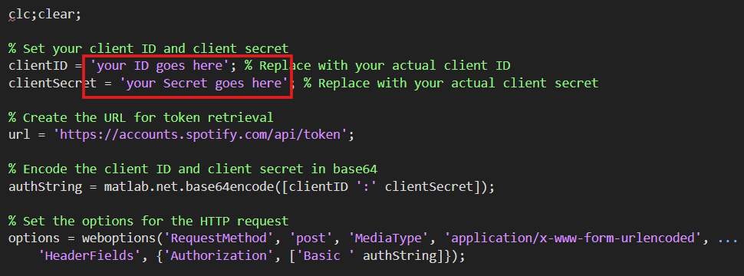
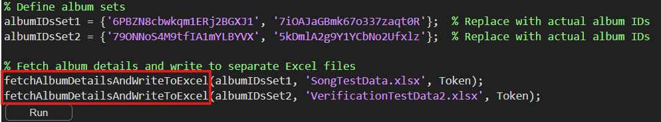
Train A KNN Model
Step 1: Access Spotify API
Run the first segment after inputting your Client ID and Client Secret from your Spotify Developer Account. This code will retrieve the data you need using the custom function fetchAlbumDetailsAndWriteToExcel().

Slide 25

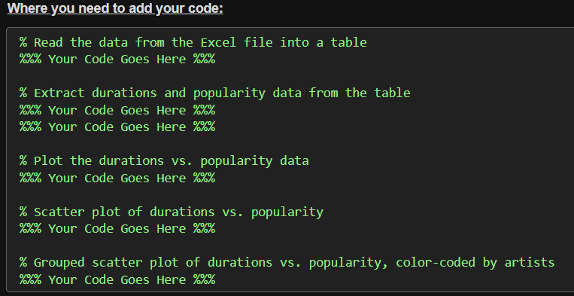
Train A KNN Model
Step 2: Read & Plot the Data
Now you need to read and plot the data stored in the file “SongTestData.xlsx”.
Hint: Name you data variable SongTestData
Hint: Review Slide 6
Hint: Review Slide 8
& group using SongTestData.artists

Slide 26
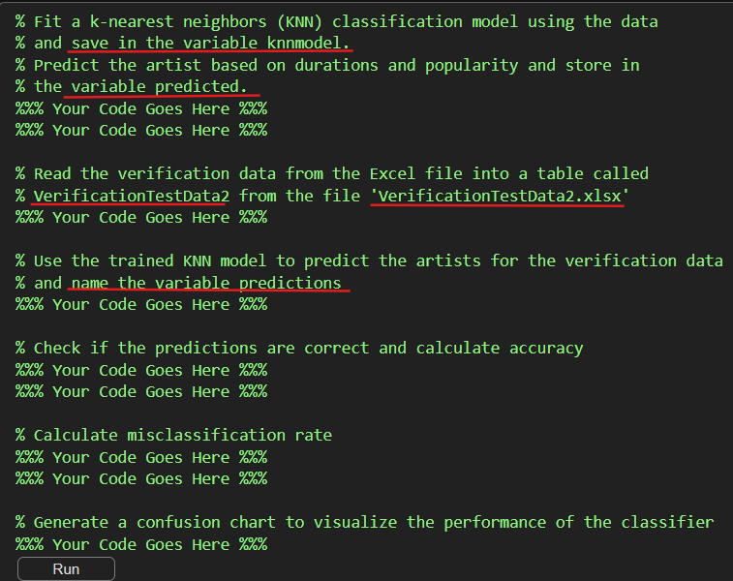
Train A KNN Model
Step 3: Fit the Model
Now fit the KNN model classification model and make some predictions.
After making predictions evaluate the accuracy.
Hint: Review Slide 15 and set the “NumNeighbors” to 8.
For your prediction use the duration 20000 & popularity of 40.
Hint: Read the new verification data and make new predictions.
Hint: Review slide 17 and slide 18
Hint: Review slide 19

Slide 27
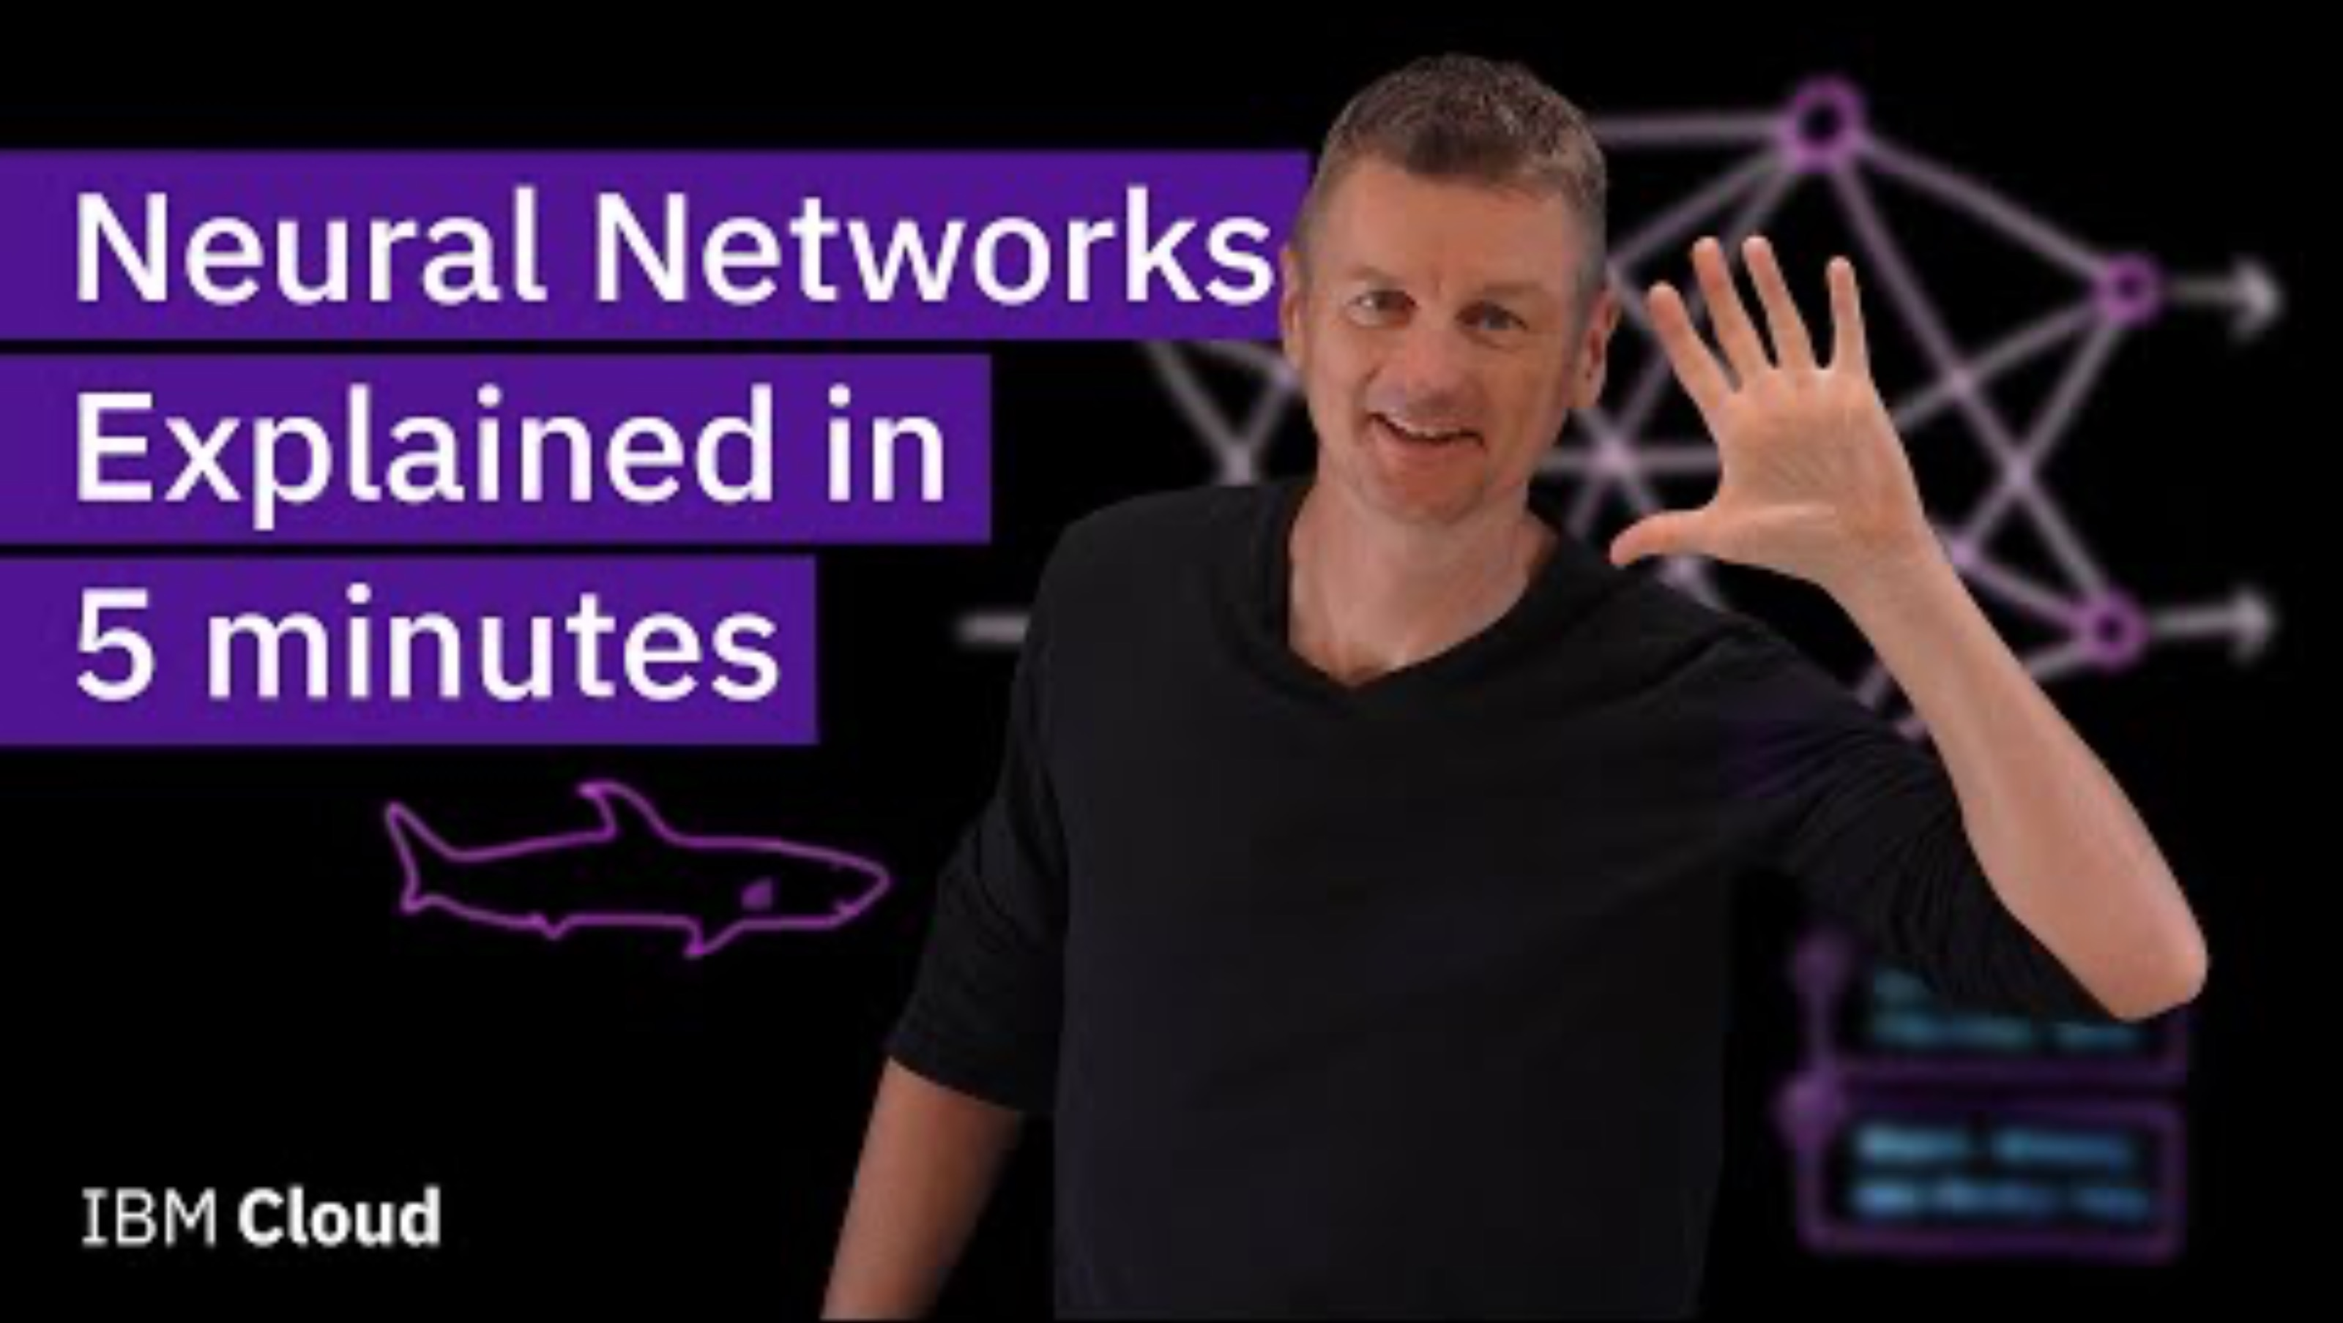

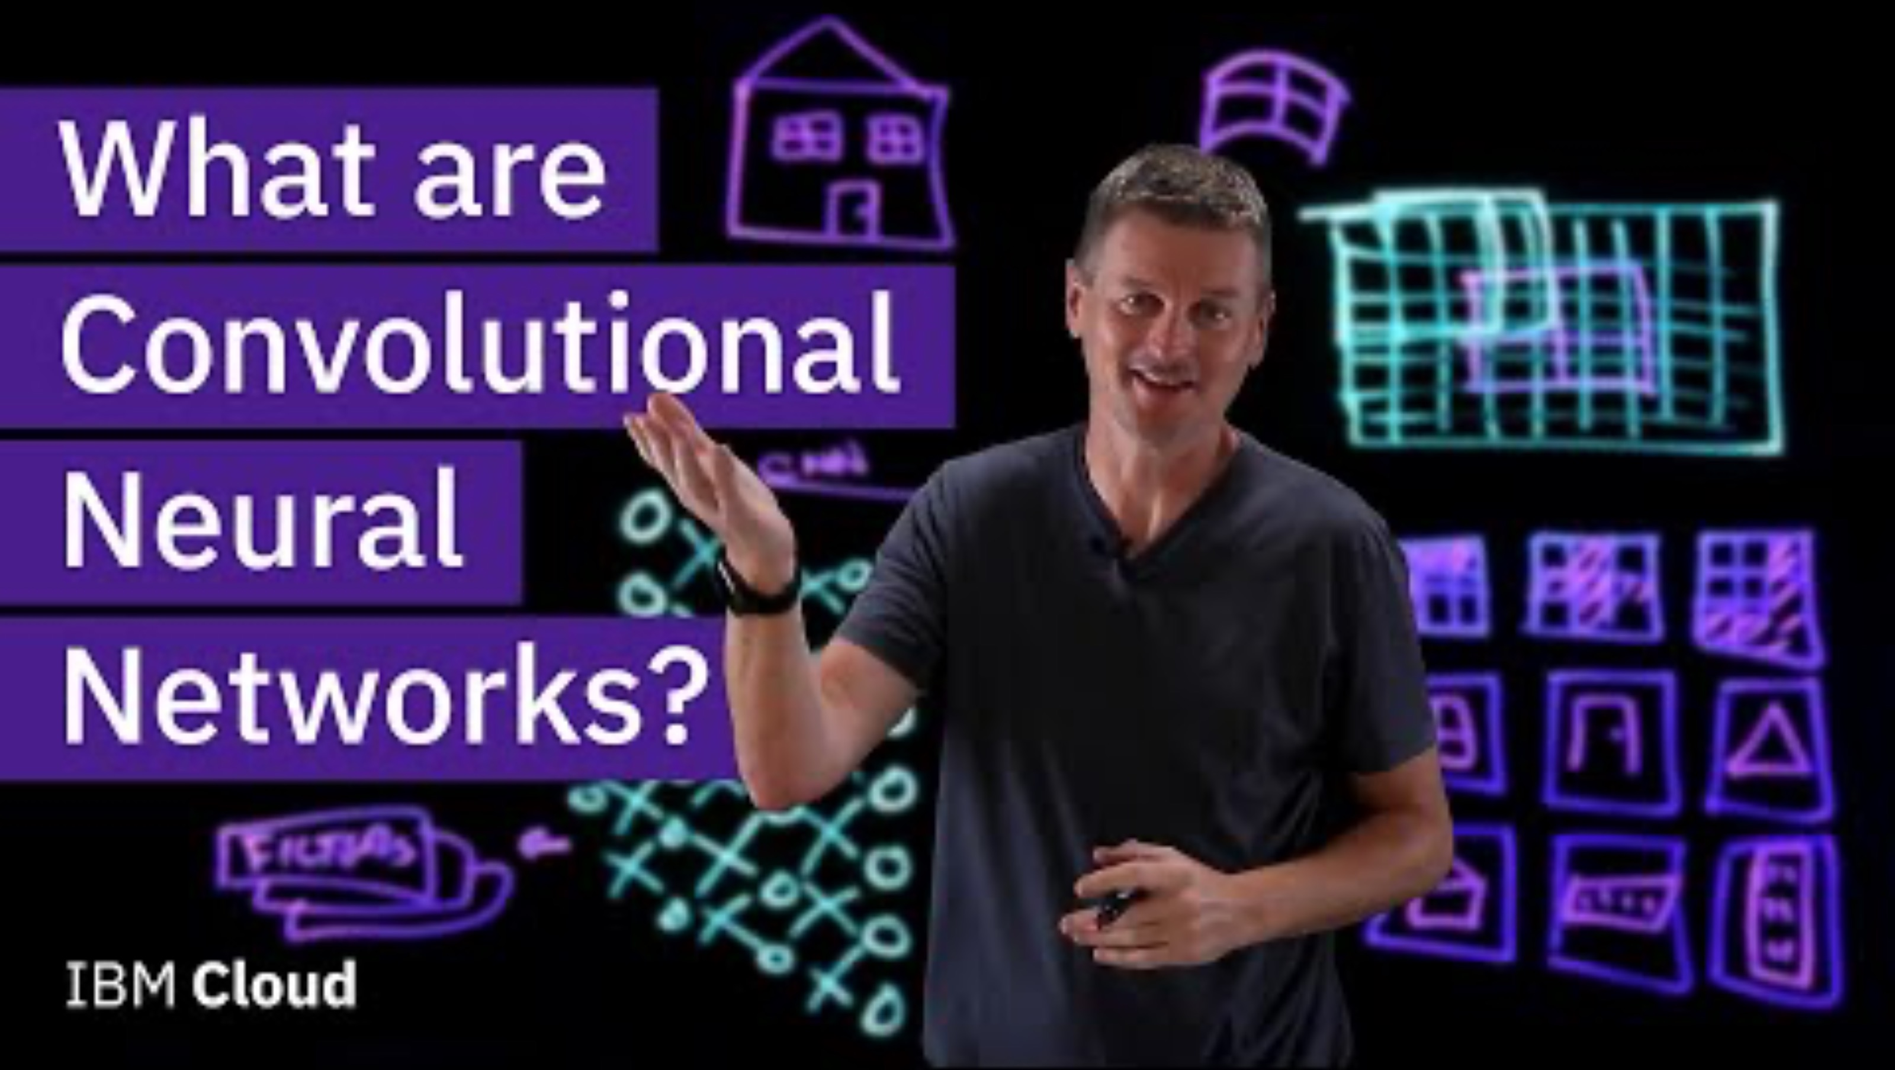
Ethical and Technological Implications of AI
What are the Impacts of Machine Learning?
Watch the following videos before having a discussion:
Link: What are Neural Networks?
Let’s discuss the following questions:
How might the use of KNN and CNN models in decision-making processes raise ethical concerns, particularly in areas like hiring, lending, or law enforcement?
In what ways have KNN and CNN models revolutionized industries such as healthcare, finance, or transportation? What are the potential benefits and drawbacks of these technological advancements?
How do KNN and CNN algorithms contribute to the phenomenon of filter bubbles and echo chambers on social media platforms? What implications does this have for societal discourse and polarization?
What do you envision as the future trajectory of AI research and development, particularly in the context of KNN and CNN models? How might these technologies evolve to address emerging challenges and opportunities?
Link : What are KNNs?
Link: What are CNNs?

Slide 28
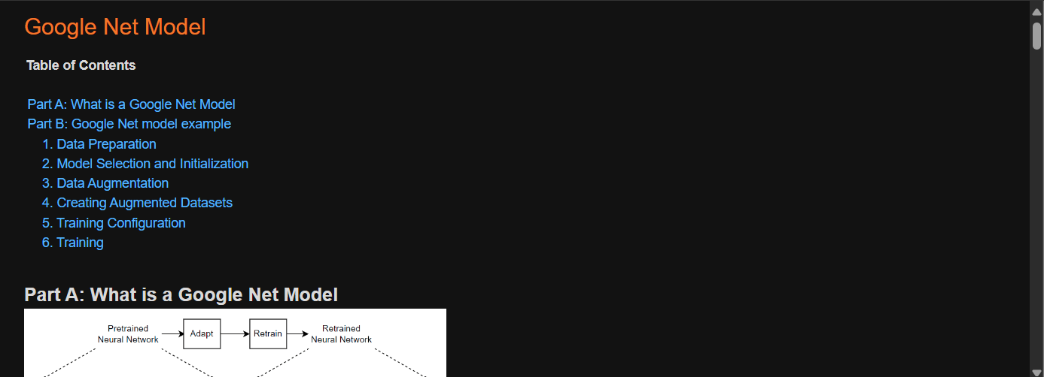
EXTRA Practice/Reference Material: Google Net Model
Please copy over the files for Section 05 from the MATLAB Drive, the “Google Net Model” live script should be in the same folder.
The MATLAB files for this section can be found at this link.
Notes:
The URL on this slide is for the student version of the files, please see the teacher guide for the teacher version of the files You can also find the teacher and student links on the master document with all the youtube video and matlab drive links for every section on it

